Slide 1
EXPLORATORY DATA ANALYSIS ON MOVIES DATASET. BY Roseline .W. Maina

Slide 2
INTRODUCTION
SCOPE: Microsoft wants to enter into the film industry. In order to provide good recommendations and advice on the entry strategy for the company, data with different information relating to the industry was analyzed.
Below I will give an overview of the steps I followed in my analysis.

Slide 3
INTRODUCTION…
DATASETS:
Below are the datasets used in this analysis to come up with recommendations for the company:
title.basics.csv - that contained data on the different movie genres
title.ratings.csv - that contained data on the respective movie ratings
tn.movies_budgets.csv - that contained data on the production budget and the revenue earned by the different movies

Slide 4
INTRODUCTION…
PROCESS FLOW:
Business Understanding
Data Exploration
Data Deployment
Data Preparation
Data Visualization

Slide 5
Business Understanding
In this phase I focused on understanding the objectives and
requirements of the project. Based off the project summary that was provided, it is evident that our client is seeking to venture into the Film Industry and would like us to provide him with insights on what types of movies are doing the best at the box office and also how different factors would affect their investment.

Slide 6
Business Understanding…
Based on this, the objectives of this analysis were:
1. Finding the relationship between the revenue and budget.
2. Finding the top 20 movies that grossed the most revenue.
3. Perform analysis on the Return On Investment(ROI).
4. Finding which movie genres had the highest ratings.
5. Finding which movie genres has the highest ROI and earned the
highest revenue.

Slide 7
Data Preparation
Here, with the data collected, I did the selection of the different fields I will use from different tables then did the data cleaning by checking to see if there are missing values in the data, the presence of outliers, invalid data, duplicates or misspelled text in the data.

Slide 8
Data Exploration
Here, I did the data exploration by checking to see if there are any patterns and relations in the data. Derive new attributes like the revenue that would help answer some of my analysis questions, integrate the data by joining different data frames also format the data where necessary.

Slide 9
Data Exploration…
Some of the activities carried out in this phase include:
Descriptive statistics like calculating the correlation coefficient, calculating the ROI etc.
Investigated the structure of the dataset and also got to familiarize myself with the different data types in the data columns and the data dimensions.
In this phase I also tackled the questions mentioned in the analysis objectives.

Slide 10
Data Visualization
In this phase, I came up with different visualization models to help me summarize and communicate my finding in a way that is understandable. Some of the models are used are bar plots and scatter plots.

Slide 11
Data Deployment
This was the final phase in my analysis. I got to communicate my findings and also provide insights and recommendations.

Slide 12
Data Deployment.…
Data Insights:
Based on the analysis carried out, I will go over the analysis questions mentioned in the objectives while sharing my findings.

Slide 13
Data Deployment.…
Relationship between Revenue and Budget:
Based on the calculated correlation and the plotted graph it is evident that the revenue and budget share a positive relationship / correlation.
This means that an increase in one will directly lead to the increase in the other.
Below is a graph to represent my findings;

Slide 14
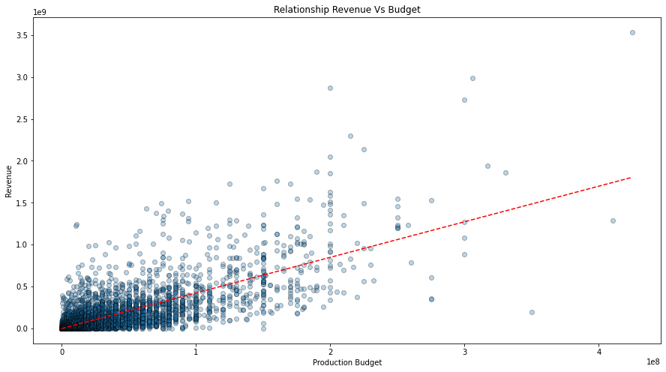
Plot Of Relationship Between Revenue and Budget

Slide 15
Data Deployment.…
2. Movies that grossed the most revenue vs. movies that had the
highest ROI
Based on my analysis, it showcased that most of the movies that had earned the highest revenue were not the same movies that had the highest return on investment.
When I dived a little deeper in my analysis it showed that the movies with the highest ROI, the year of release of most was in the early 90’s and a few the early 2000’s.
Based on this I came to the assumption that the value of the money invested in the budget during that period does not hold the same value in the present day due to factors like inflation over the years.
Below are two graphs showing the top 20 movie that earned the most revenue and the top 10 movies with the highest ROI

Slide 16
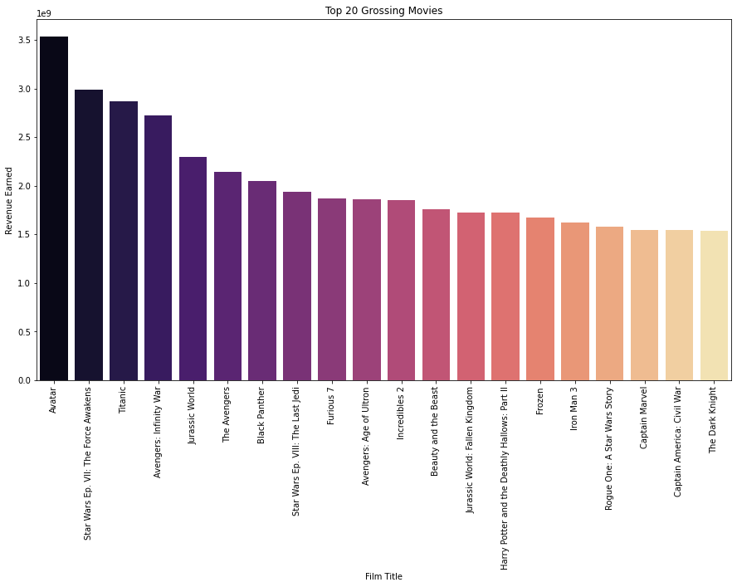
Plot Of The Top 20 Movies that Earned the Most Revenue

Slide 17
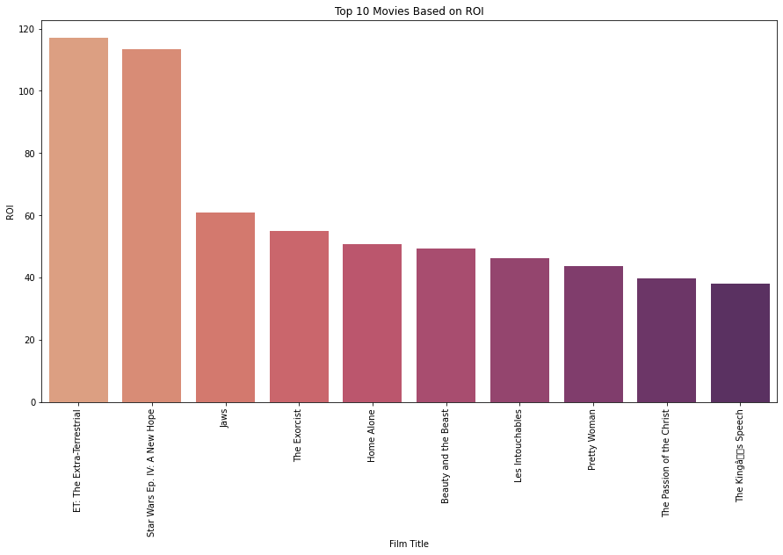
Plot Of The Top 10 Movies With The Highest ROI

Slide 18
Data Deployment……
3. Movie genres that had the highest rating, earned the
most revenue and had the highest Return on investment.
Based on my analysis, it showed that the movie genres with the highest rating was game-shows and music.
The movie genres that earned the most revenue was family and fantasy.
The movie genre with the highest return on investment are musical and animation.
Below are three graphs to showing the :
‘Distribution of Film Genres by Ratings’
‘Distribution of Revenue by Genre’
‘Distribution of ROI by genre’

Slide 19
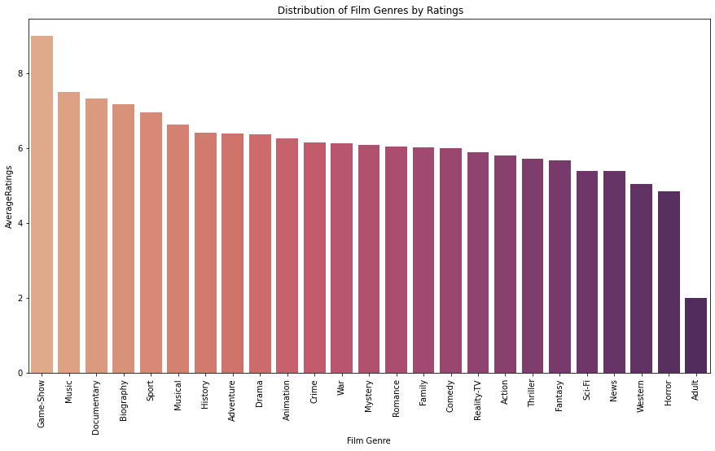
Distribution Of Film Genres By Ratings

Slide 20
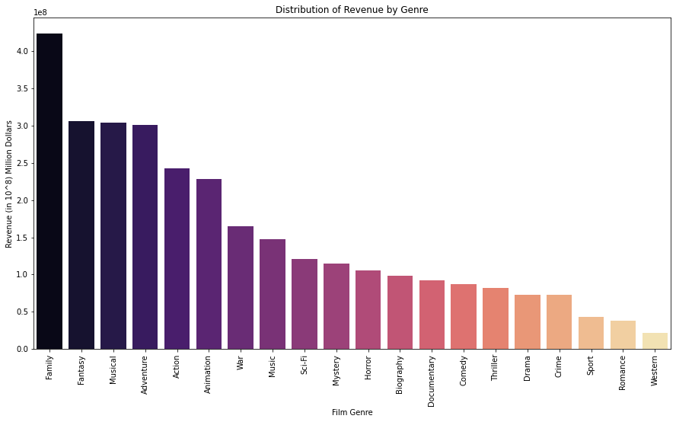
Distribution Of Revenue By Film Genre

Slide 21
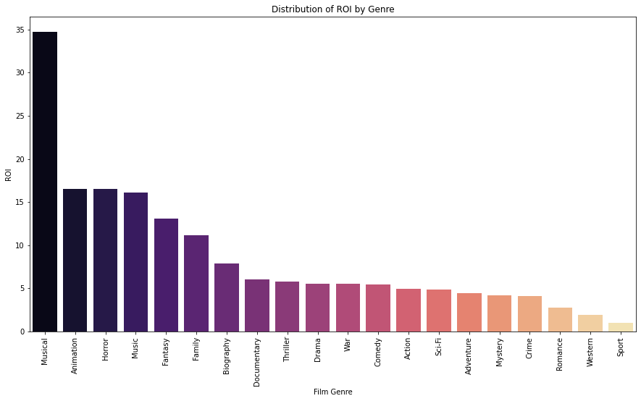
Distribution Of ROI By Film Genre

Slide 22
Data Deployments……
Recommendations:
Based on our findings, its clear that the budget invested directly affects the revenue earned therefore the more you invest in the budget the higher the revenue earned.
When it comes to the movies that earned the most revenue and had the highest return on investment, I’d recommend that it’s better to invest in the movie genres that are likely to earn you the most revenue and give the most return on investment.
Some of these genres are:
Family and fantasy genre that earned the highest revenue
Musical and Animation genre that had the highest return on investment
Game-show and Music genre with the highest ratings

